Slide 1





ABP Community News
Alper EBICOGLU
@alperebicoglu
ABP Core Team Member
@ebicoglu

Slide 2

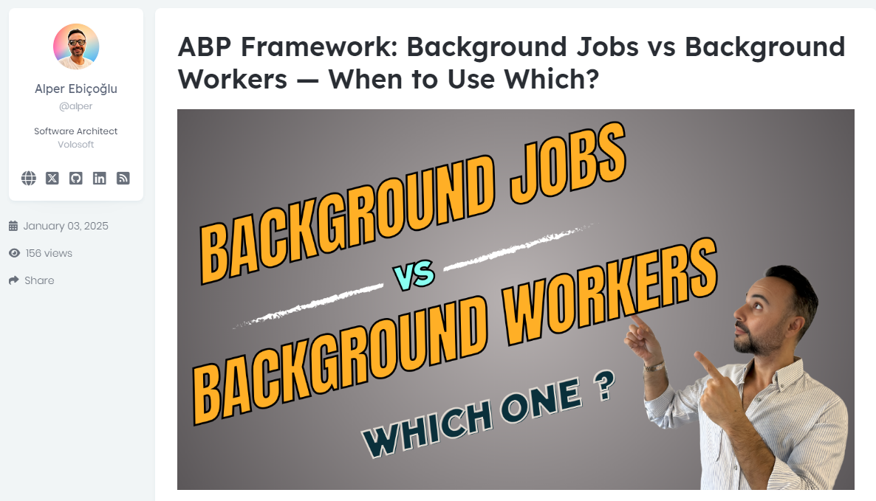

Community News
https://abp.io/community/articles/abp-framework-background-jobs-vs-background-workers-when-to-use-which-t98pzjv6

Slide 3
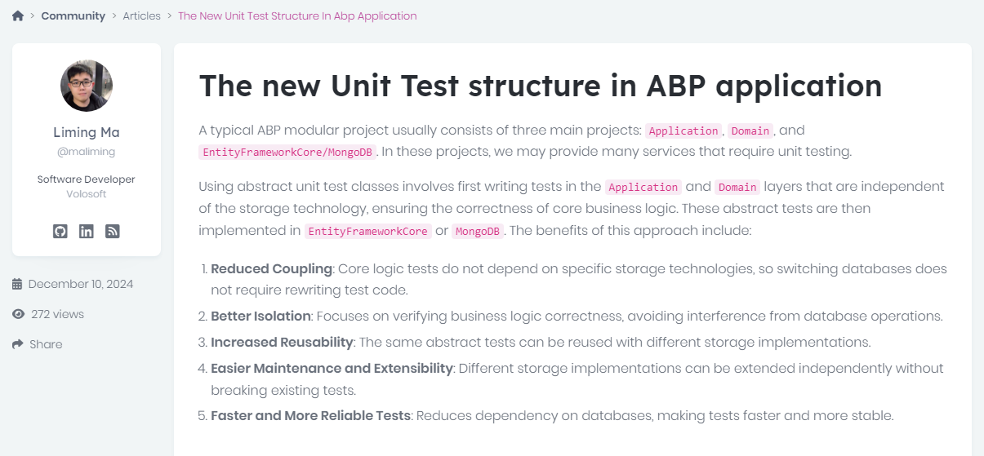

Community News
https://abp.io/community/articles/the-new-unit-test-structure-in-abp-application-4vvvp2oy

Slide 4
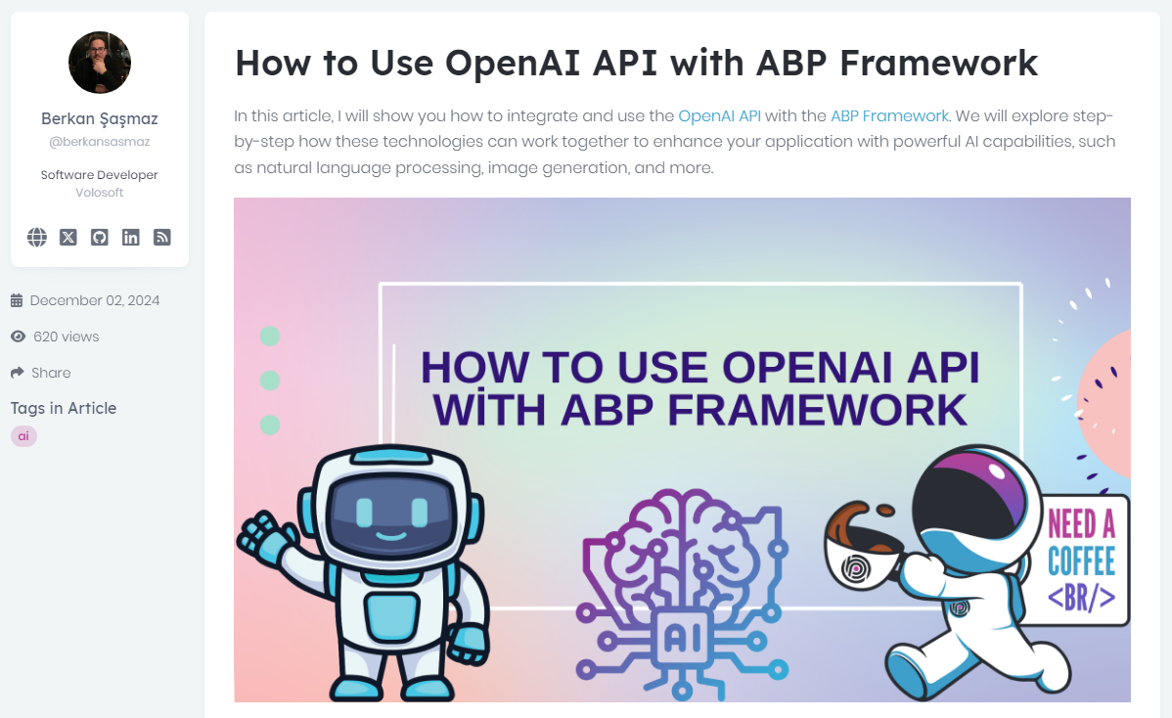

Community News
https://abp.io/community/articles/how-to-use-openai-api-with-abp-framework-rsfvihla

Slide 5








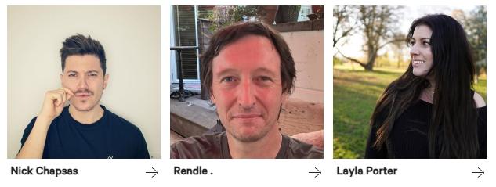



Slide 6




That’s all from me ☺
Follow me on Twitter
Alper Ebicoglu
https://twitter.com/alperebicoglu
https://github.com/ebicoglu
https://medium.com/@alperonline

Slide 7
How does data management differ between modular monolithic and microservices architectures, particularly concerning data consistency and integrity?

Slide 8
How does the complexity of managing microservices compare to that of a well-structured layered architecture?

Slide 9
What are the key differences between layered and microservices architectures, and how do they impact scalability and maintainability?

Slide 10
In which scenarios would a modular monolithic architecture be more advantageous than microservices?

Slide 11
What are the challenges associated with transitioning from a layered architecture to a microservices-based system?

Slide 12
How do deployment strategies differ between modular and microservices architectures?

Slide 13
What are the performance impacts of inter-service communication in microservices compared to intra-layer communication in layered architectures?

Slide 14
What are the best practices for maintaining module boundaries within a modular monolithic architecture to prevent tight coupling?

Slide 15
What are the best practices for maintaining module boundaries within a modular monolithic architecture to prevent tight coupling?
Each module should handle a single purpose.
Expose only what’s necessary through interfaces; keep internals private.
Use dependency injection or abstractions to avoid direct dependencies.
Each module owns its data; share only via APIs.
Test modules independently to maintain boundaries.
Prefer event-driven or message-based communication over direct calls.

Slide 16
How do layered and microservices architectures handle cross-cutting concerns like security and logging?

Slide 17
What factors should be considered when deciding between a layered, modular, or microservices architecture for a new project?

Slide 18
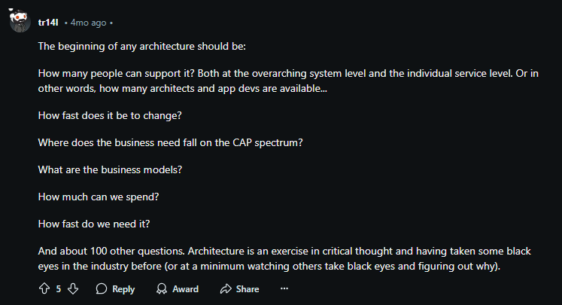
Notes:
https://www.reddit.com/r/softwarearchitecture/comments/1f75l7r/comment/ll7f0o2/

Slide 19
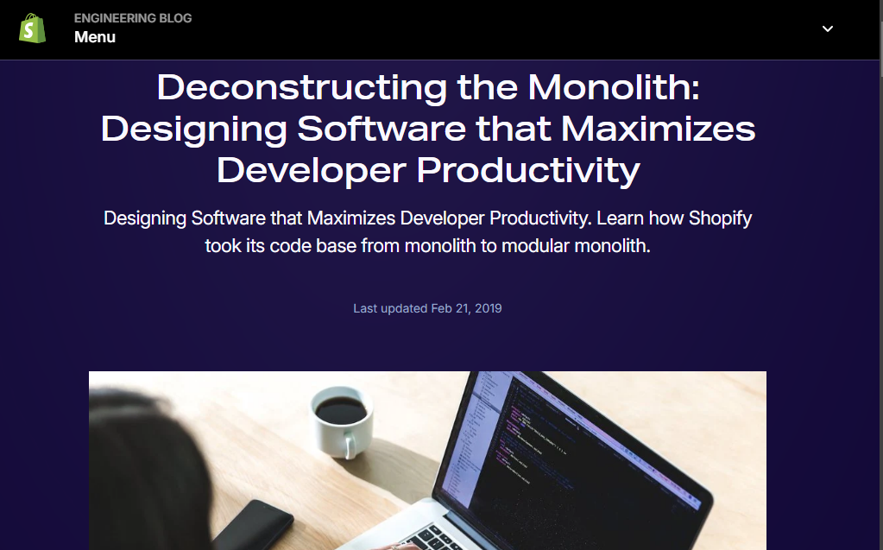
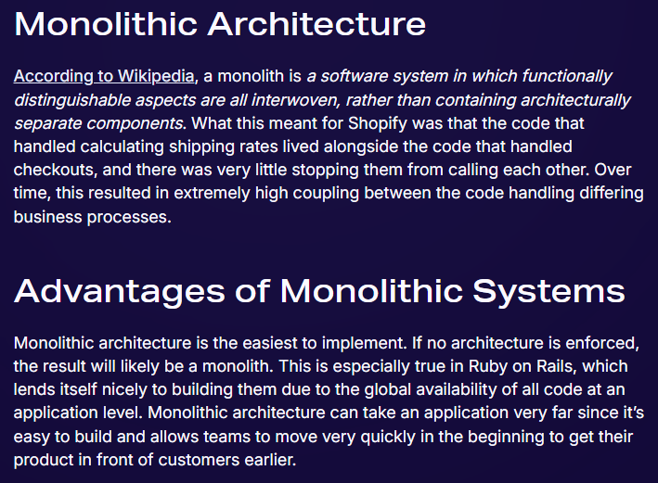
Notes:
We’re going to explore the fascinating world of Shopify’s Modular Monolithic Architecture https://shopify.engineering/deconstructing-monolith-designing-software-maximizes-developer-productivity

Slide 20
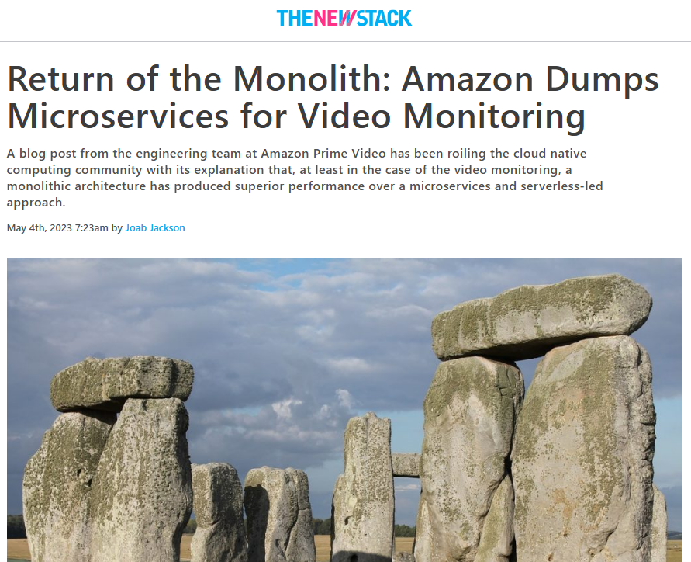
https://thenewstack.io/return-of-the-monolith-amazon-dumps-microservices-for-video-monitoring/
Notes:
Amazon returned to a Monolith for there Video Monitoring
https://thenewstack.io/return-of-the-monolith-amazon-dumps-microservices-for-video-monitoring/

Slide 21

Notes:
https://www.reddit.com/r/dotnet/comments/15sltta/comment/jwfiefs/

Slide 22
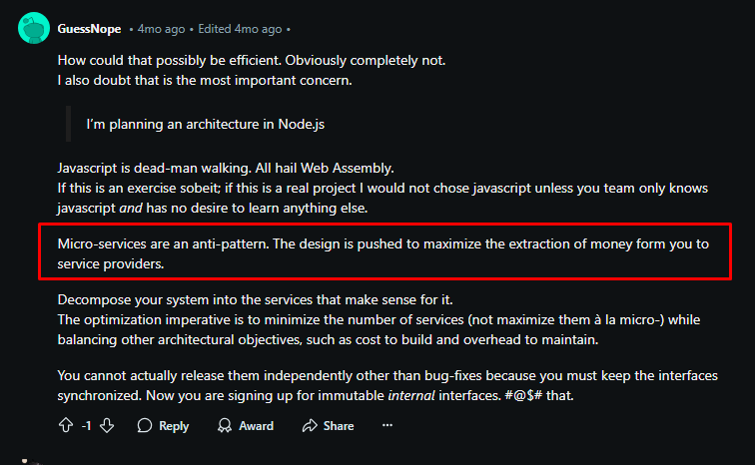
Notes:
https://www.reddit.com/r/softwarearchitecture/comments/1f75l7r/is_it_efficient_to_orchestrate_a_modular_monolith/

Slide 23
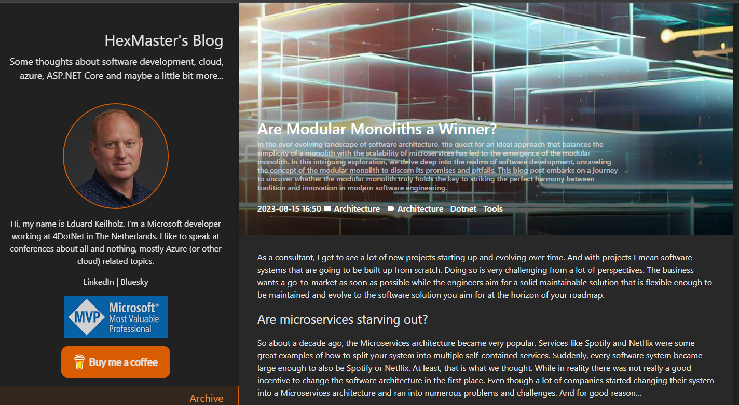
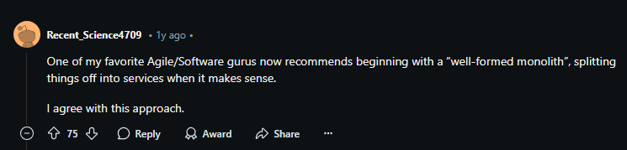
Notes:
Microservices gained popularity for their modularity and scalability, but they often introduce significant complexity and challenges, especially in messaging and maintenance, which can hinder rapid development and MVP delivery. A Modular Monolith approach combines the benefits of monoliths and microservices by organizing code into distinct modules within a single system, reducing plumbing complexity while retaining scalability and separation of concerns as the system evolves.
https://hexmaster.nl/posts/are-modular-monoliths-a-winner/

Slide 24
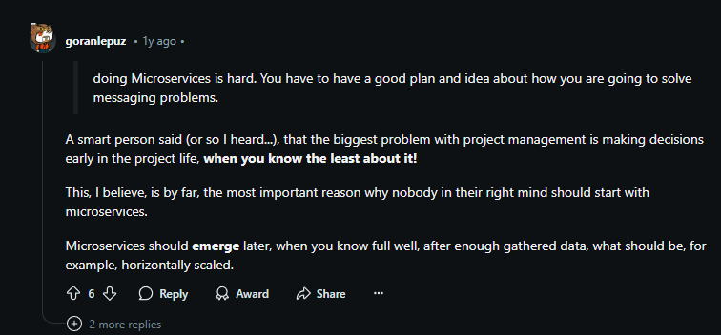

Notes:
https://www.reddit.com/r/dotnet/comments/15sltta/are_modular_monoliths_a_winner/

Slide 25
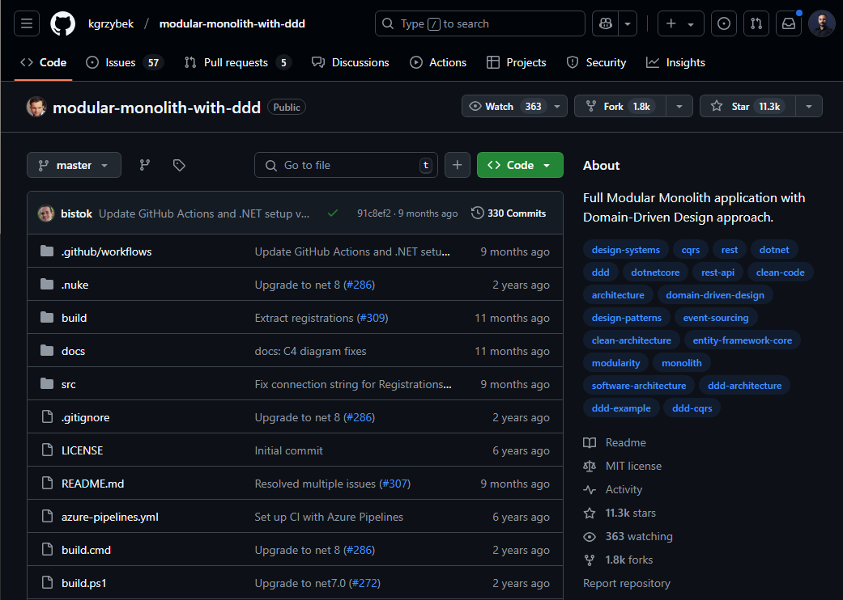
https://github.com/kgrzybek/modular-monolith-with-ddd
Notes:
https://github.com/kgrzybek/modular-monolith-with-ddd

Slide 26
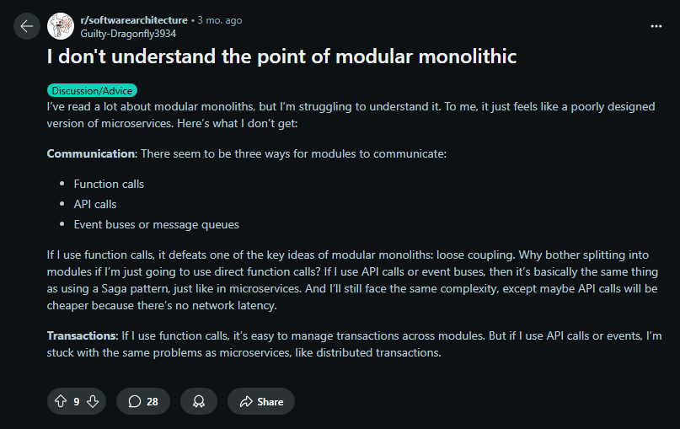

Slide 27
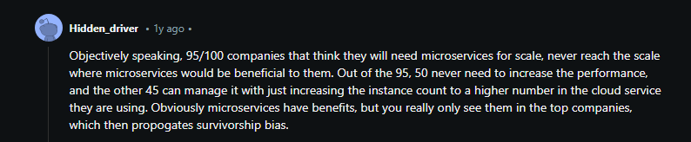
Notes:
https://www.reddit.com/r/dotnet/comments/15sltta/comment/jwfgo8i/

Slide 28
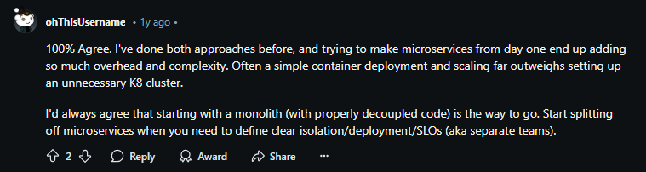
Notes:
https://www.reddit.com/r/dotnet/comments/15sltta/comment/jwhr6ae/

Slide 29
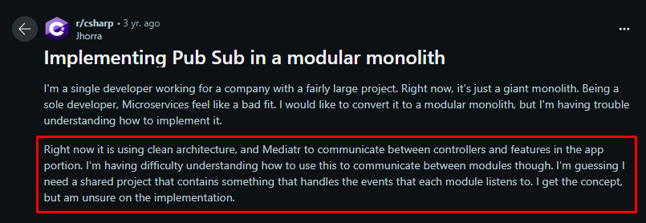
Notes:
https://www.reddit.com/r/csharp/comments/pyt0ka/implementing_pub_sub_in_a_modular_monolith/

Slide 30
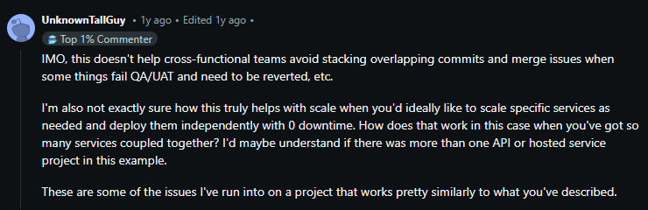
Notes:
https://www.reddit.com/r/dotnet/comments/15sltta/comment/jwfj5f8/

Slide 31
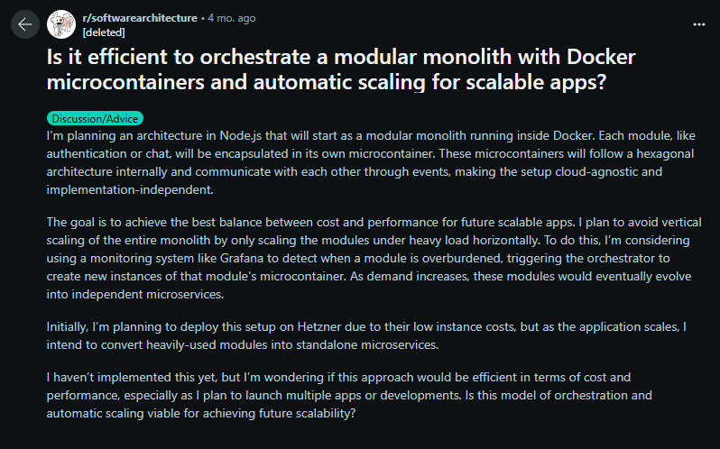
Notes:
https://www.reddit.com/r/softwarearchitecture/comments/1f75l7r/is_it_efficient_to_orchestrate_a_modular_monolith/

Slide 32
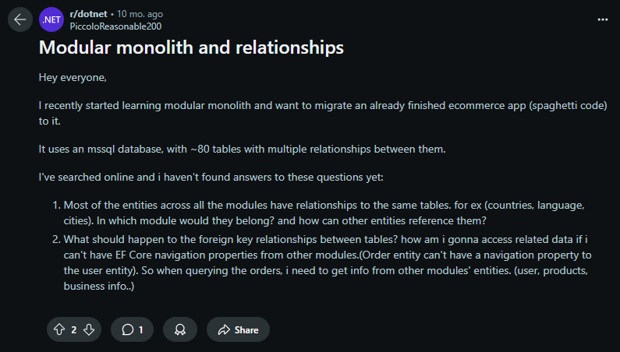
Notes:
https://www.reddit.com/r/dotnet/comments/1bd6g2p/modular_monolith_and_relationships/

Slide 33
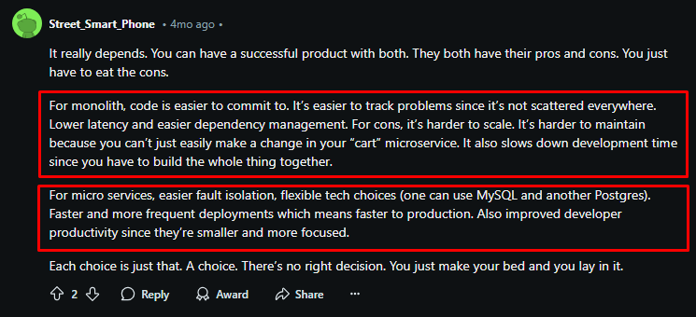
Notes:
https://www.reddit.com/r/sre/comments/1fg19nl/comment/ln087u2/

Slide 34
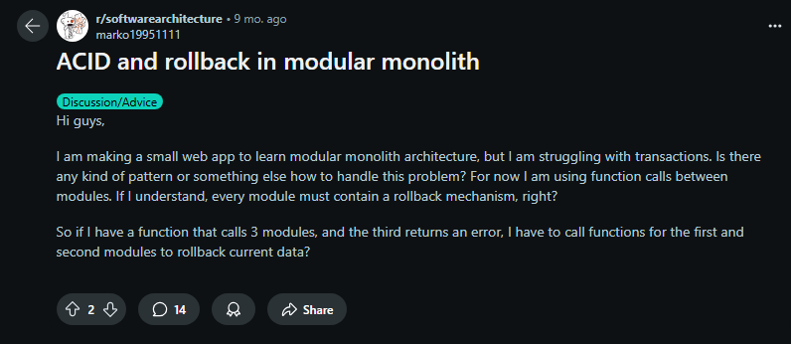
Notes:
https://www.reddit.com/r/softwarearchitecture/comments/1c9z9sv/acid_and_rollback_in_modular_monolith/

Slide 35
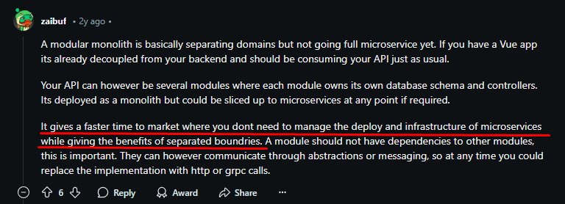
Notes:
https://www.reddit.com/r/csharp/comments/101bp7h/comment/j2mykuj/

Slide 36
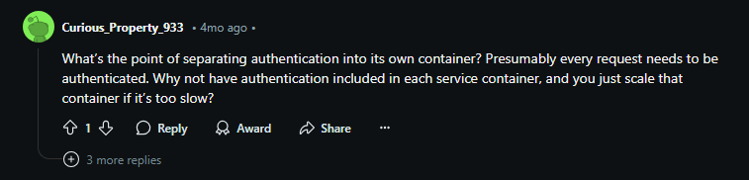
Notes:
https://www.reddit.com/r/softwarearchitecture/comments/1f75l7r/comment/ll75f59/

Slide 37
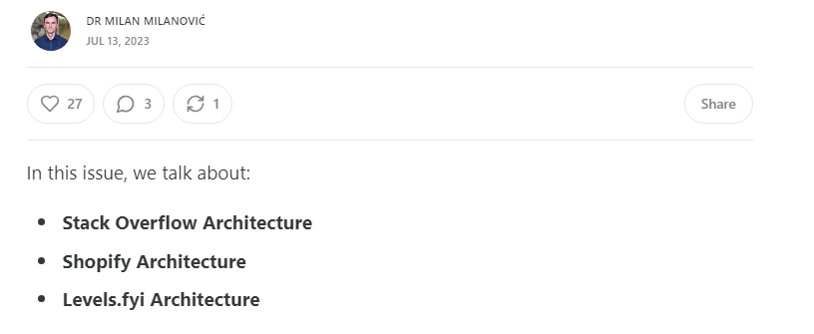

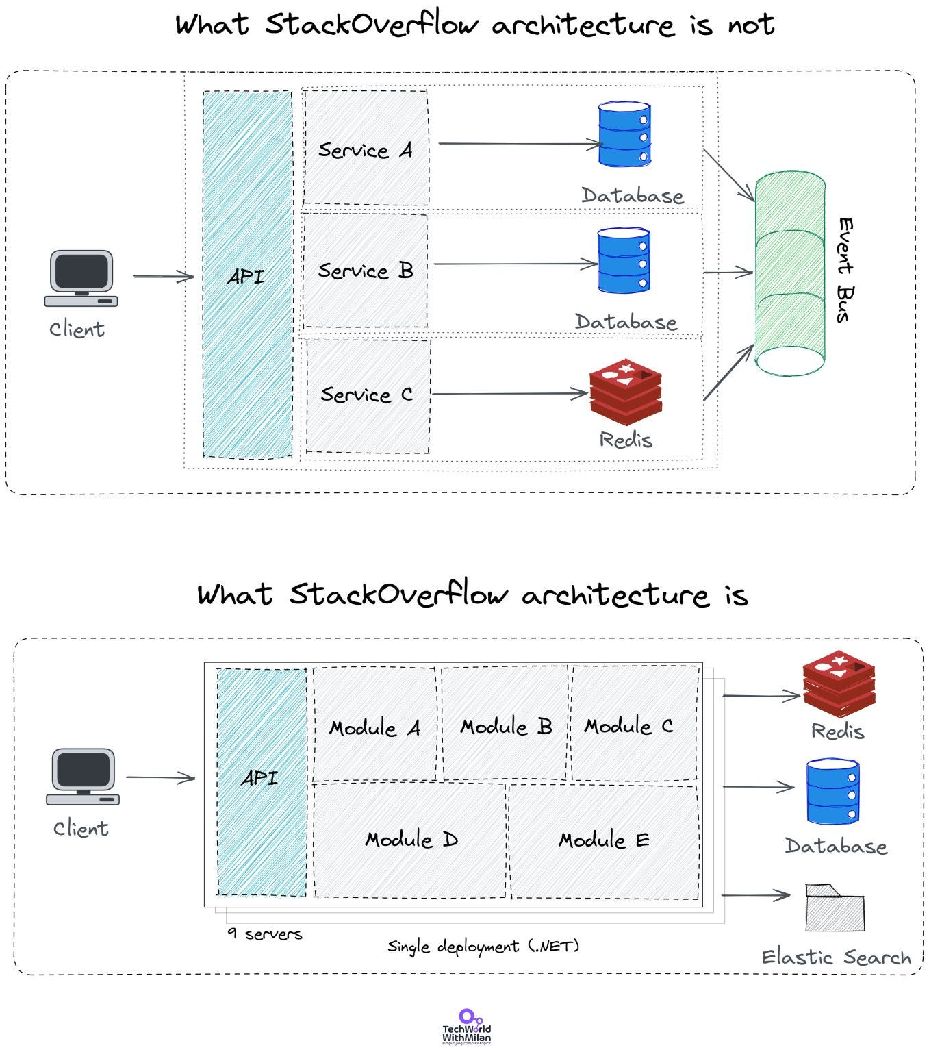
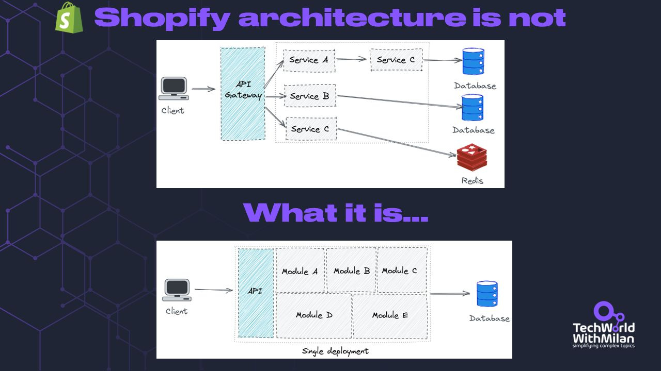
Notes:
https://newsletter.techworld-with-milan.com/p/stack-overflow-architecture

Slide 38
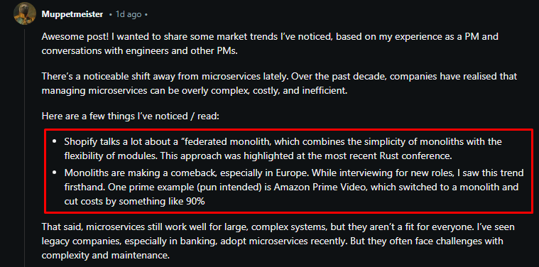
Notes:
https://www.reddit.com/r/ProductManagement/comments/1hqlj8u/comment/m4rrct0/

